Slide 1
November 2018
Summary of the report for sharing with stakeholders and participants in the study
Task: ‘to independently explore and evaluate models, terms, conditions, assertions and arguments relating to the creation, enhancement, ownership, licensing, distribution and use of bibliographic metadata’.

Slide 2
Questions posed to libraries
Part 1 – The NBK Business Model
The first phase of work focused on articulating a clear set of ‘value propositions’ (VPs) for the NBK to better understand the metadata issues and requirements that will influence and enable the NBK to deliver those value propositions.
Activity What is the (specific) function/service offering? | Who is it for? Who are the users being targeted | Value/Benefit Why would they use this? How does it help them? What problems does it solve? | Benefit Delivery How does the service/offer deliver this benefit? | Metadata What are the implications | Competition Can the user get the benefit from elsewhere? –Where? | Rating How important is this VP?

Slide 3
Community Evaluation of NBK Value Propositions
NBK Value Proposition | Description | Score
Collection management | Benchmark collections against peers | 2-5
UK Research Reserve (UKRR) | Provide the core infrastructure for UKRR | 3-5
Resource discovery | For end users | 3-5
Resource discovery | For librarians - e.g. to support ILL | 2-5
Shared cataloguing service | Inc. catalogue record download | 2-5
Ebooks | Better discovery & management of eBooks | 2-5
Improved discovery | Enhance and upgrade data | 2
Community endeavour | Cost effective community collaboration & coordination | 3-5
Syndication and visibility | Get library data more discoverable in wider web | 2-4
Research around published material | Data for market research | 3-5
Visible aggregation of records | For the data suppler- Facilitates distribution of records | 2-4
5 = Fundamental
1= Not important

Slide 4
NBK Value Propositions – Conclusions & Recommendations
Conclusion
The NBK team’s VPs are valid and resonated with the library community
There was a large degree of consensus. Unsurprisingly however, considering the variety of HE institutions we spoke to, there was not universal agreement about how important the VPs were
Recommendations
The NBK should focus on the core Value Propositions and ensure they are facilitated by the appropriate bibliographic metadata arrangements
The value of core NBK services varies according to different kinds of customer. This will be a consideration in terms of how NBK services are promoted and marketed.
The NBK is operating in a competitive environment and needs to put in place a process that constantly monitors the competitive landscape

Slide 5
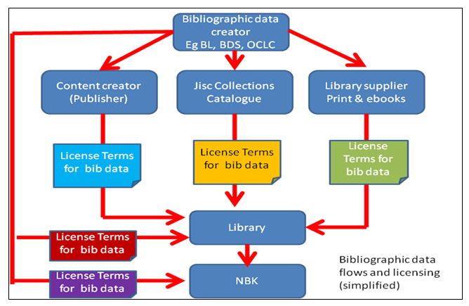
Bibliographic Metadata
Part 2 – Bibliographic Metadata
The second phase of work focused on a library engagement exercise to find out what providers they used, what types of resource (print books and e-books) they acquired records for, whether they had an explicit license agreement with the data provider, and what the license terms were.

Slide 6
Evaluation of Supply, Demand & Licensing
Metadata Supply From …
Ex Libris
British Library
Copac/RLUK
Library of Congress
OCLC
BDS
Nielsen
Other UK Academic Library (e.g. Bodleian)
Askews
ProQuest
Dawsons
EBSC (GOBI)
Metadata Demand from …
Coventry University
Durham University
University of Leeds
Manchester Metropolitan University
University of Salford
Teesside University
SCURL (Stirling, Glasgow, Edinburgh, Glasgow Caledonian)

Slide 7
General Statements
Complexity
“Given the complexities […] it is not surprising that license terms including restrictions on record re-use are generally not well articulated or well understood.
Motivations
“An important factor in the UK market for bibliographic metadata is to understand the motivations of the key players in terms of bibliographic data. Although complex in detail, (providers may play multiple roles for example, in both consuming and creating data) it can be usefully summarised …”

Slide 8
Motivations & views on NBK development
Kind of Provider | Motivations around metadata | Potential views of NBK
Publishers | Metadata is a tool for discovery and hence sales. Publishers prioritise data about pricing and terms (expressed for example in ONIX) rather than ‘library specific’ data such as Library of Congress subject headings (LCSH). MARC is not a format that meets their needs | Another channel for discovery.
Bibliographic data businesses/utilities E.g. BDS, OCLC, Capita (Base) | These provide ‘library quality’ data (e.g. MARC, RDA, LCSH and Dewey) Bibliographic metadata is a core part of the business. They charge directly or indirectly for data. | The shared cataloguing element of the NBK is a potential threat
Library management systems vendors E.g. Capita, ExLibris Innovative, OCLC, SirsiDynix, | Library quality bibliographic metadata is a key facilitator of the software application business. | Mixed. ExLibris, Innovative and SirsiDynix have no real axe to grind. They just want their customers to have good quality data available as easily and cheaply as possible. Capita and OCLC offer shared cataloguing services that are to some extent in competition with the NBK
Library suppliers E.g. Ebsco, ProQuest, Dawsons, Askews etc | Bibliographic metadata is a cost to the core business. | NBK could be an opportunity to improve workflows and reduce costs

Slide 9
Conclusions
Bibliographic metadata licensing: conclusions
“Current arrangements are complex and neither librarians nor data providers appear to have a clear grasp of the full picture. There is a multiplicity of bibliographic data providers driven by a variety of motivations that are reflected in an array of separate license arrangements.
Part of the confusion is due to the fact that, up to now, license arrangements have focussed on enabling the provision of bibliographic metadata rather than on enabling its re-use.
The NBK is a game changer. If it is to deliver its core value propositions effectively and economically there needs to be a significant shift towards a more open licensing environment to permit re-use of bibliographic metadata.”

Slide 10
Recommendations
Bibliographic metadata licensing: Recommendations
Use the Jisc supported ‘Open Metadata Principles’ as a guiding framework*
Leverage the power/influence of Jisc in the market to enable metadata re-use to support the NBK value propositions
Create a new bibliographic metadata license [clause] that can be implemented as part of the Jisc Collections license
Create a new bibliographic metadata license [clause] that can be implemented from July 2019 onwards as part of the joint procurement framework negotiations around the supply of print and e-books etc.
As part of the above establish a clear definition of what is required in terms of metadata quality
Progress negotiations with stakeholders around achieving the validated value propositions. Negotiate around interests not positions
As part of the negotiation around the licensing of records for the future establish a clear settlement over the terms of records currently in circulation
* Open Metadata Principles - http://discovery.ac.uk/businesscase/principles/

